Slide 1
The ME-Retailer Engagement System has 6 components:
ASM Dashboard (Tactical Decision Layer)
3
Leadership Dashboard (Strategic Intelligence Layer)
2
Engagement Reports
∑ (ME-Retailer engagements)
1
ME App
6
Continuous Evolution (Ongoing Improvement Layer)
Retailer Intelligence (AI + Rules Layer)
Retailer
4
ME
Retailer Data - Feedback, Objections, etc.
Nudges / Campaigns (Execution Layer)
5

Slide 2
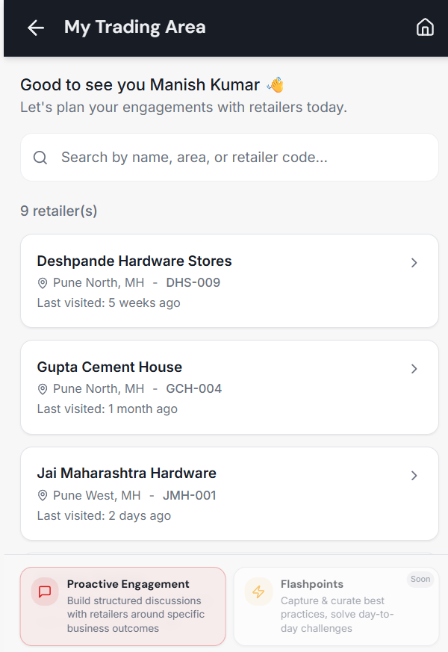
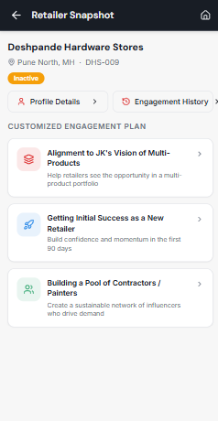
ME App
Goal (what it does): MEs use the app to have structured conversations with each of their retailers as part of their day-to-day engagements.
What it contains?
Trading Area View - List of all the Retailers
Retailer Profile – location, products handled, revenue, engagement history, etc.,
Library of Engagement Units
Customized engagement Plan (E.g.: Getting Initial Success as a New Retailer)
Core Discussion Points (E.g.: Higher Profit Pool, Full Customer Solution, Low-Risk Expansion)
Retailer Action points / Go-forwards
Key critical feedback points from retailer (E.g.: Customers complain the setting time feels inconsistent)
Retailer Visit Reports
Measures / Outcomes:
Objections raised by the retailer for each of the core discussion points (E.g.: Discussion: JK's Vision of Multi-Products, Objection: No demand in My area)
Retailer Action points / Go-forwards
Specific action points linked to objections (E.g.: Start with a small trial batch to test actual demand before committing further)
Independent action points to achieve the overall Engagement Units (E.g.: I'll try 2–3 relevant SKUs with contractors before the next meeting to see if it works for me)
Key critical feedback points from retailer [new]
Behavioural inputs – Willingness to promote JK, scheme response, etc.
Retailer sentiment -competitor push, credit stress, demand
Engagement Outputs [new]
Engagement Duration – GPS, Engagement Units clicks (time from starting the Engagement Units to sharing the report)
Summary Report
ME preparation [new]
Time spent by ME reviewing Retailer snapshot / engagement plan ??
Ground level insights/ challenges [new] (For e.g. Due to poor packaging of Putty, retailers in Pune are not selling it during monsoon)
Operational Protocols (for JK):
ME uses it as part of daily field visits to each & every retailer
Ensure ME covers inactive / new retailers
Cover all Engagement Units for a retailer in 6 months
Nudges (say, majority have no demand in this area)
Interaction with other components of the system:
Retailer Intelligence Component - Get the CEP, core discussion points, retailer dimensions and retailer morphology; Send retailer action points / go-forwards, key critical feedback, retailer-raised objections and ground level insights
ASM Analytics Dashboard – send visit reports
Actionable Improvements – receive nudges

Slide 3
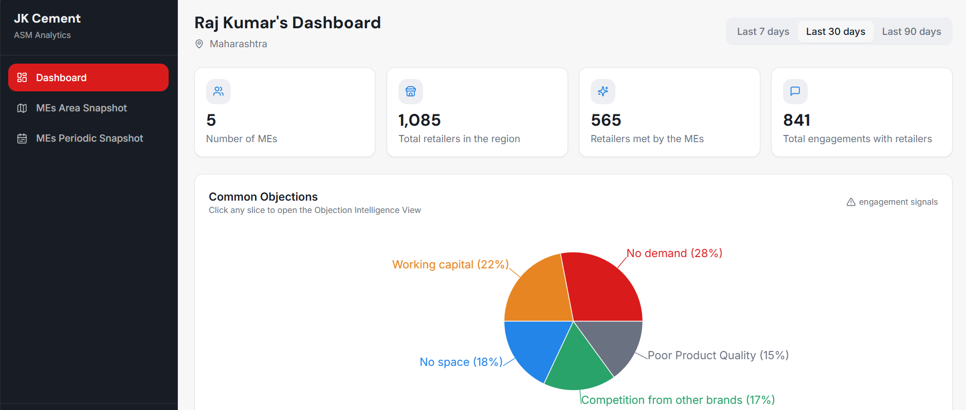
ASM Analytics Dashboard
1. Objective / Goal (what it does):
Aggregated visibility for ASMs across the MEs they oversee - patterns, objections, and engagement quality.
2. What it contains? (product concept):
ASM will be able to view high-priority, repeating objections & take actions (Area-level objection patterns)
Ask MEs to focus on specific engagements that address high-priority objections
For low demand outlets, he can ask DGs to increase focus on them
Retailer morphology (loyal, new, inactive, declining)
ASM will be able to track how many inactive/ declining retailers are being engaged and ask ME’s to focus on inactive/ declining retailers
Retailer dimensions (JK alignment, value prop, market awareness, openness, growth potential)
ASM can ask his MEs to spread market awareness among the retailers if its consistently low.
ME engagement breakdown
Daily visit reports of MEs
ME Profile View
3. Measures / Outcomes:
ME effectiveness
Objections reduction rate
Inactive to active retailer
Dominant retailer dimensions / leaderboard (E.g.: 80% of the retailers in the area are aligned to JK’s vision; This area stands 4th in the country in terms of alignment to JK’s vision)
4. Interaction with other components of the system:
ME App - Get the daily visit reports of MEs with the retailers
Retailer Intelligence component - Get the objection analysis data, retailer morphology, retailer dimensions and other measures
Actionable Improvements – receive nudges

Slide 4
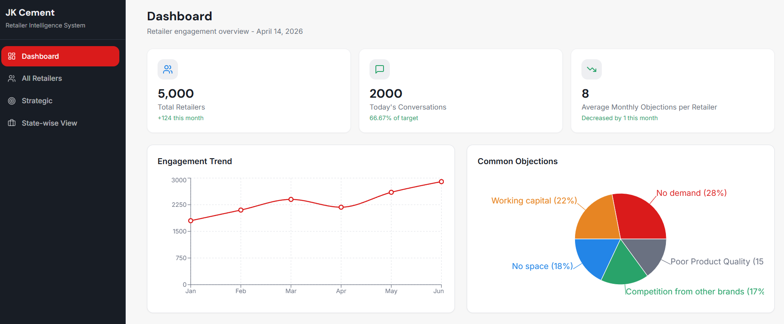
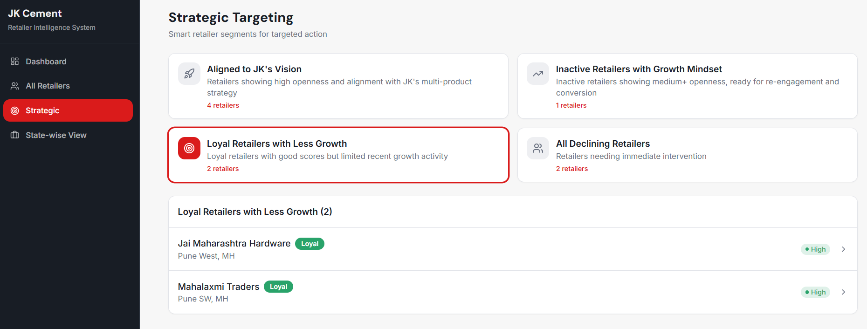
Leadership Dashboard
Objective / Goal (what it does):
To enable the leadership to have strategic vision of retailer network and track the quality of engagement at the state/area level to take appropriate actions.
What it contains? (product concept):
Retailer morphology (loyal, new, inactive, declining)
Retailer dimensions (JK alignment, value prop, market awareness, openness, growth potential)
Strategic targeting - smart retailer segments for targeted action (E.g.: Inactive Retailers with Growth Mindset; Loyal Retailers with Less Growth)
ASM-ME engagement breakdown
ME profile view
Retailer profile view
Measures / Outcomes:
Area-level and overall ME effectiveness
Overall objections reduction rate
Inactive to active retailer
Dominant retailer dimensions / leaderboard (E.g.: 70% of the retailers in the country are aligned to JK’s vision; Rajasthan tops the country in terms of alignment to JK’s vision)

Slide 5
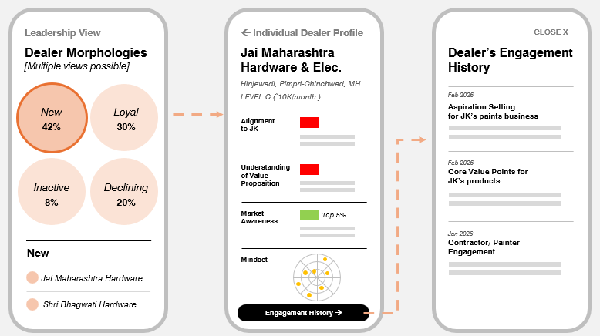
1. Objective / Goal (what it does):
The core backend analytics component to makes the entire system self-sustaining by generating proactive insights & triggers, detects patterns by providing emerging trends.
2. What it contains? (product concept):
Pre-seeded information about the retailers
Raw data from the ME App post each engagement with the retailer
Objections ((E.g.: Start with a small trial batch to test actual demand before committing further)
Action points / go-forwards (E.g.: I'll try 2–3 relevant SKUs with contractors before the next meeting to see if it works for me)
Key critical feedback
Engagement Duration
Time spent by ME reviewing Retailer snapshot and/or Customized Engagement Plan
Profiles of ME and ASM
Processed data using available existing data and derived data
Behavioural inputs – Willingness to response, scheme response
Retailer sentiment -competitor push, Credit Stress, Demand
3. Measures / Outcomes:
Customized Engagement Plan
Generate the retailer morphology and dimensions(attributes) as well as retailer engagement trends
Generate objection analysis data at an area and overall level
Generate retailer segments for the leadership’s strategic actions.
4. Interaction with other components of the system:
Illumine internal team (or) JK design team - Static data pre-seeding (from outside the system) ??
ME App - Get data w.r.t objections, retailer action points, key critical feedback; Send back Customized Engagement Plan, core discussion points, retailer dimensions and retailer morphology
ASM analytics dashboard, leadership dashboard – Send objection analysis data, retailer morphology and retailer dimensions and other measures
Actionable Improvements – send data on objections, retailer morphologies, dimensions and other measures
Retailer Intelligence Layer

Slide 6
Nudges/Campaigns
Objective / Goal (what it does):
To use Retailer intelligence to provide actionable field plans & recommendations for MEs and enable ASMs to nudge the MEs
To move from monitoring-driven performance to reflection-driven improvement
2. What it contains? (product concept):
ME nudge engine which provides preparation nudges before the visit, real time reminders during the visit and reflection and follow through nudges after the visit (E.g.: You haven’t visited these inactive retailers in a while. Have a look at them)
ASM nudges with area wide improvement suggestions, best practices for objection identified (E.g.: 40% of the retailers in your area are reporting ‘No demand’ for JK’s multi-products)
3. Measures / Outcomes:
Engagement Unit Coverage:
Objection raised vs Objection addressed
Outcome signals:
Retailer dimensions and morphological changes
Adoption rate
Behavioral & Skill signals:
Active-to-inactive retailers covered
Loyal-to-inactive retailers covered
Repeated avoidance of certain engagement units
Area-level signals:
Engagement unit effectiveness
4. Interaction with other components of the system:
ME App - send nudges before, during, and after an engagement visit; send nudges based on his retailer morphologies covered so far
ASM analytics dashboard, leadership dashboard – Gives nudges to the ASM and leadership on objections addressal action points completion and ground level insights
Retailer Intelligence – get data on objections, retailer morphologies, dimensions and ground level insights
Continuous Improvement Layer - get improvement triggers and redesign nudges

Slide 7
Continuous Evolution
1. Objective / Goal (what it does):
To ensure Retailer Engagement System itself evolves based on field reality
Converts thousands of engagement instances into system-level learning
Continuously refine:
Engagement units
Conversation structure
Objection Handling logic
Retailer action playbook
2. What it contains? (product concept):
Engagement performance review engine:
How Engagement units are being used
Where conversations succeed or stall
Which engagement constructs are weakening over time
Pattern Diagnosis and root-cause layer
Engagement units showing declining effectiveness
High effort but low/no improvement Objections
3. Measures / Outcomes:
Design effectiveness measures
Engagement unit – outcome conversion rates
Objection type – Stall or progress outcome
4. Interaction with other components of the system:
Retailer Intelligence - extract raw engagement performance data; send updated engagement units, revised objection handling logic
Actionable Improvements -Sends improvement triggers and redesign nudges.

Slide 8
Market Discovery Systemic components
ASM Dashboard (Tactical Decision Layer)
3
Leadership Dashboard (Strategic Intelligence Layer)
2
Cluster Reports
Cluster Engagement Plans
∑ (Cluster Potential)
1
DG App
6
Continuous Evolution (Ongoing Improvement Layer)
Market & Cluster Knowledge Base
(AI + Rules + Knowledge Base Layer)
Market
4
DG
Cluster potential, engagement plan recommendations, sales enablers
Nudges / Campaigns (Execution Layer)
5

Slide 9
DG App
Goal (what it does): For Demand Generators to discover the market potential in their area and systematically engage with local customer groups
What it contains?
Market Potential Mapping – List of top clusters in the area (their potential, competitive strength, ease of sales)
Cluster Engagement Plan – Customer Groups, Value Proposition, contribution events recommendation)
Customer Sales Enablement – enablers at each stage of the sale in the form of pamphlets, decks, customized action points (from identification, contacting, proposing solutions, closing the sale to followup)
Cluster potential report
Cluster engagement report
Measures / Outcomes:
Access level of the DG in a cluster
Overall market potential in a cluster
Action plans for cluster engagements (planning camps & events, capturing contacts of contractors, retailers, stakeholders of that cluster)
Enablers used for a prospect sale
Sales engagement happenings
Operational Protocols:
DG uses the app on a regular basis to explore / untap the potential of cluster in the area
DG to mark their access level for the clusters
DG to prioritize going after top potential x access level clusters
Create a cluster engagement plan along with the ASM
Make use of the sales enablers to go after prospects in a cluster

Slide 10
ASM Analytics Dashboard
1. Objective / Goal (what it does):
Help ASMs identify where DGs are concentrating their efforts, assess cluster-level priorities, and measure the progress and effectiveness of co-created cluster engagement plans
2. What it contains? (product concept):
Top market clusters (in terms of potential & access) in the area
What are DGs prioritizing as clusters?
Penetration level progress at each cluster
Consolidated & individual cluster reports generated by DGs
Consolidated & individual cluster engagement plans co-created
Effectiveness of engagement plans co-created
3. Measures / Outcomes :
High potential – high access clusters in the area
% of DGs prioritizing each cluster
% of DGs prioritizing each cluster type (such as HP – HA, HP – LA.,etc)
DG-wise execution strategy status
Where do DGs stand in the sales funnel?
Penetration % and MoM % increase at each cluster level
% conversion from cluster engagement

Slide 11
Leadership Dashboard
Objective / Goal (what it does):
To give the leadership a view into top market clusters and enable them to strategize market penetration with the help of the sales teams
What it contains? (product concept):
Top market clusters (in terms of potential & access)
What are ASMs & DGs prioritizing as clusters?
Penetration level progress at each cluster
Measures / Outcomes:
High potential – high access clusters across the country, states or regions
% of DGs prioritizing each cluster
% of DGs prioritizing each cluster type (such as HP – HA, HP – LA.,etc)
DG-wise execution strategy status
Where do DGs stand in the sales funnel?
Penetration % and MoM % increase at each cluster level

Slide 12
Market & Cluster Knowledge Base Layer
1. Objective / Goal (what it does):
The core analytics component in the backend which generates, stores & captures dynamic knowledge intelligence for the market & clusters.
2. What it contains? (product concept):
All major clusters in a region
Cluster revenue potential, competitive strength, ease of sale and their sources
Cluster-wise customer groups, value proposition pitch, contribution events
Cluster-wise sales enablers including pamphlets, decks, customized action points; prospects in each sales stage
3. Measures / Outcomes:
Cluster access level & overall cluster potential
Contacts like contractors, retailers, other stakeholders w.r.t. specific clusters
DGs targeted customer groups, VP, contribution events planned for cluster engagement
Capture DGs chosen sales enablers
Effectiveness of the engagement plan & contribution events

Slide 13
Nudges/Campaigns
Objective / Goal (what it does):
To use the knowledge base layer to provide actionable recommendations to conduct contribution events & execute sales effectively for DGs and enable ASMs to nudge the DGs
2. What it contains? (product concept):
Nudge engine provides how to effectively execute the engagement plans devised by the DGs; provide triggers to get through the sales cycle with necessary nudges along the way
ASM nudges with area level recommendations in targeting specific clusters for a week for their DGs
3. Measures / Outcomes:
Best practices nudge - Best execution practices for contribution events
Potential clusters nudge – Providing signals to go after HP – HA clusters on priority basis
Sales nudge – providing necessary nudges at each stage of a prospect sales cycle to execute it effectively

Slide 14
Continuous Evolution
1. Objective / Goal (what it does):
To ensure Market Discovery System itself evolves based on field reality
Continuously refine the cluster engagement plan, triggers for contribution events, pamphlets, decks provided, sales enablers based on its effectiveness in the engagement.
2. What it contains? (product concept):
Engagement & enablers performance review engine:
How are pamphlets, deck., etc being used
Gaps in cluster engagement plan
How are sales enablers aiding in moving prospects
3. Measures / Outcomes:
Design effectiveness measures
Overall cluster potential vs ease of cluster engagement & sales
Customer cluster engagement plan effectiveness
Sales enablers effectiveness
4. Interaction with other components of the system:
Retailer Intelligence - extract raw engagement performance data; send updated engagement units, revised objection handling logic
Actionable Improvements -Sends improvement triggers and redesign nudges.

